Slide 1
Neural Modular Networks
Joseph E. Gonzalez
Co-director of the RISE Lab jegonzal@cs.berkeley.edu

Slide 2
Today

Slide 3
What Problem is being solved?
Problem Domain: Visual Question Answering
“Visual Turing test”

Slide 4
Prior State of the Art
Semantic parsing and logic:
Dependent on pre-trained computer vision models to populate database
Jointly Learning to Parse and Perceive: Connecting Natural Language to the Physical World

Slide 5
Prior State of the Art
Deep Embeddings
Learned end-to-end but image representation is independent of the question.
Image Question Answering: A Visual Semantic Embedding Model and a new Dataset
Are you Talking to a Machine? Datasets and Methods for Multilingual Image Question Answering

Slide 6
Proposed Solution
Compose a neural network to answer question
Use parser to extract logical expression from question.
Reuse network components across problems

Slide 7
Question:
Is there a circle next to a square?
Logical Expression:
is(circle, next-to(square))
Objective: Convert question into logical expression.
Conceptually → Inducing a program from a question
Also probably the more brittle part of the work
Addressed in follow-up paper
Alternative solution: user writes logical expression → programming

Slide 8
Neural Modules
“Learned Sub-routines/Functions”
Separate weights for each argument e.g., [dog]

Slide 9
Composition!
Separate weights for each argument e.g., [dog]
“Learned programs”
“What color is his tie?”

Slide 10
Composition!
Separate weights for each argument e.g., [dog]
“Learned programs”
“What color is his tie?”
“Is there a red shape above a circle?”
color(tie)

Slide 11
Training
Separate weights for each argument e.g., [dog]
Train multiple graphs at once with shared modules.
“What color is his tie?”
Individual models learn through their composition.
color(tie)
No pre-training

Slide 12
Evaluation Metrics and Results
Accuracy on VQA benchmarks
Existing benchmarks only require limited reasoning…
Introduce new Shapes Benchmark
Shapes Benchmark
VQA Benchmark

Slide 13
Qualitative
Results

Slide 14
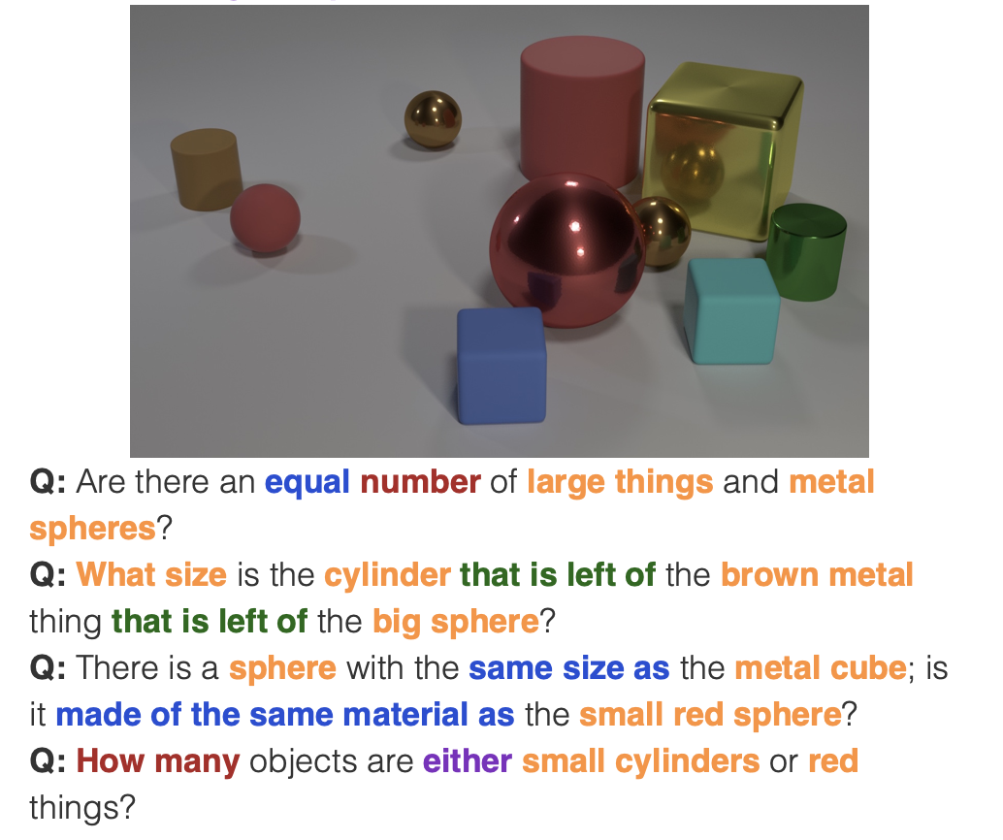
Impact
Over 300 citations (pretty good)
Follow-up work “Learning to Reason: End-to-End Module Networks for Visual Question Answering” address limitations of parsing.
Uses Policy RNN to predict composition (trained using RL)
Notes:
CLEVR dataset

Slide 15
Points to a bigger opportunity…
Composition of learned modules
Conjecture: Increasing “non-experts” will compose existing ML models to solve new complex problems.
Organizations will develop and reuse model components in multiple tasks
Training will span many different neural module programs
Needed?
Abstractions for individual components
Mechanisms for composition and joint training

